Slide 1
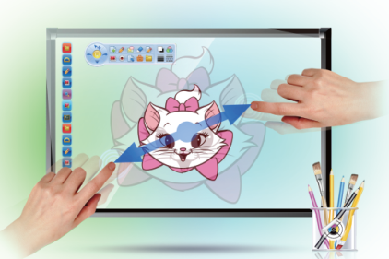
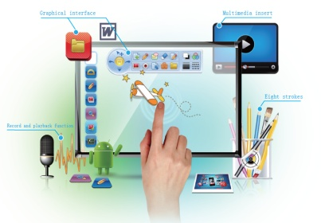
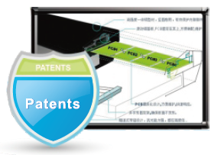
Interactive Whiteboard
IB-89T
Large screen
Active Size:85.4”
Aspect Ratio:4:3
Honored:
Multi Touch
Multi touch, support finger or opaque object to write
Finger Gesture Recognition
Use finger gesture to zoom In, zoom out or erase contents, this make operations more simple
Powerful Teaching Software
The provided interactive software provide dozens of useful teaching tools for choice
Environment-Friendly
No chalk dust is generated, good for teacher and students’ healthy
Nano Surface
Strong, anti-damage and anti-glare.
Modular Design
Easy for maintenance, problematic PCB boards can be easily pulled out and exchanged

Slide 2
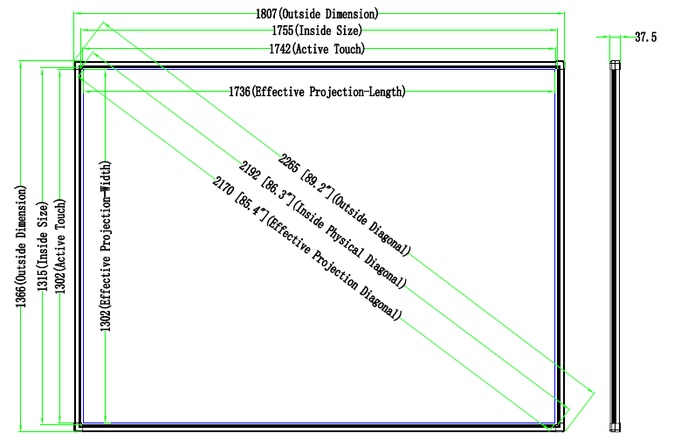
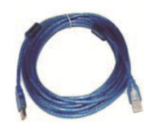
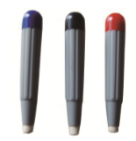
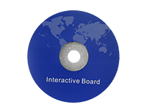
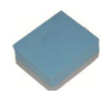
89” 4:3 Interactive Whiteboard
IB-89T
Total Area Size: 1807x 1366mm
Active Size: 1742 x 1302 mm
Total Area Diagonal Size: 89.2”
Active Diagonal Size: 85.4”
Aspect Ratio: 4:3
Surface Material: Cold rolled steel surface, anti-damage, nano surface, anti-glare, suit for projecting high quality images and inscriptions.
Wick Material: High density polyfoam
Back: Galvanized Steel Sheet
Accessories
X 4
Wall mounts USB cable Pens Pointer Eraser Software CD

Slide 3
TECHNICAL SPECIFICATIONS
Hardware Special Features | Gesture recognition
Technology | Infrared
Calibration | 4 points, 9 points
Touch Point | 10 touch
Cursor Speed | 180 dot/s
Display ratio | 4:3
Resolution | 32768 x 32768
Positioning Accuracy | <2mm
Connecting Port | USB 2.0 USB 1.1 USB 3.0
Response rate | less than 6 milliseconds
Protection against noise | Not subject to AD/ magnetic interference.
Interactive tray | interactive tray with pockets for markers 4 colors and eraser. determine the color of the raised marker. Have the ability to simultaneous use of markers of different colors. Software with self-diagnosis function of the infrared field. Plug & Play LED indicator.
View Angle | Horizontal 170°, vertical 160°
Operating System | Windows 2000, Windows XP, Windows Vista, Windows 7, Windows 8.1,Windows 10, Linux, Mac, Android
Connection | USB cable, wireless module (optional)
Power Supply | USB power supply DC 4.6V- 5.0V <1W ( 100mA at 5V)
Working Condition | Indoor or Outdoor
Storage | Temperature: -30°C~60°C Humidity: 0%~95%
Operation | Temperature: -10°C~45°C Humidity: 10%~90%
Installation | Wall mounted, cabinets, mobile stand (optional)
PHYSICAL SPECIFICATIONS
Model | IB-89T
Overall Size (mm) | 1807x 1366
Overall Diagonal (inch) | 89
Aspect Ratio | 4:3
Board Weight (kg) | 28
Gross Weight (kg) | 36
Product Dimension (mm) | 1807x 1366 x 34mm
Packed Size (mm) | 1927 x 1485 x 90 mm

Slide 4
SOFTWARE FUNCTIONS
 | IB-89T
Modes of operation | control (mouse), abstract, full screen, a window and a transparent layer. Preparation and preservation of lessons: Virtual instruments for precise operations: Guarantee at least 3 years
Preparation and preservation of lessons | rotating, moving and resizing objects, including adding comments and snapshots of the screen; progressive playback actions on objects; automatic recognition and optimization of geometric shapes and polygons; add hyperlinks to objects; giving transparency of objects; inserting patterns and images in the background and use; organization of pages; gallery; Move objects from page to page, or from one application to another; attachment files; saving files in various formats (e.g., PDF or HTML); saving pages as a separate image files (eg, JPEG or GIF); mesh configuration page; insert animation files from the gallery, and add their own files; a wide variety of drawing tools that differ by connection type, style, letters, type, dashed lines, etc .; Showing information with the effects of imposing shadows and lighting. The curtain, spotlight, magnifier to increase the individual sites. Access to most applications through a software control panel. Floating instruments.
Virtual instruments for precise operations | a compass, a triangle, a ruler and protractor. Enter text with the on-screen keyboard. Automatic export to Office formats, on the web sending by email. Setting palette. The program supports the ability to play different files at the same time. Software support multivideo lets you play in different threads and freely adjust them. The window size can be changed by moving the cursor around the screen. To make full screen, double-click on it. During video playback, you can use the notes on the screen.
Warranty | 3 years

